Slide 1

Digital Logic Design Project
Bangladesh University of Professionals

Slide 2
Group Members:
NABIL WALID RAFI(2154901005)
HASSAN MEHEDI (2154901019)
SHAIKH MAHMUD (215490119)

Slide 3
Our Presentation topic:
Automatic Light at Night

Slide 4
Introduction:
Automatic Night Light is used to turn on lights automatically when sun goes down before night.
Most Common Uses:
In the developed countries, street, highway lamp lights automatically turn on before night and stays on until it turns itself off autmotically, at morning, when we don’t need light.
We can use this feature at our home, apartment to keep our property secured from theft and crimes in darkness

Slide 5
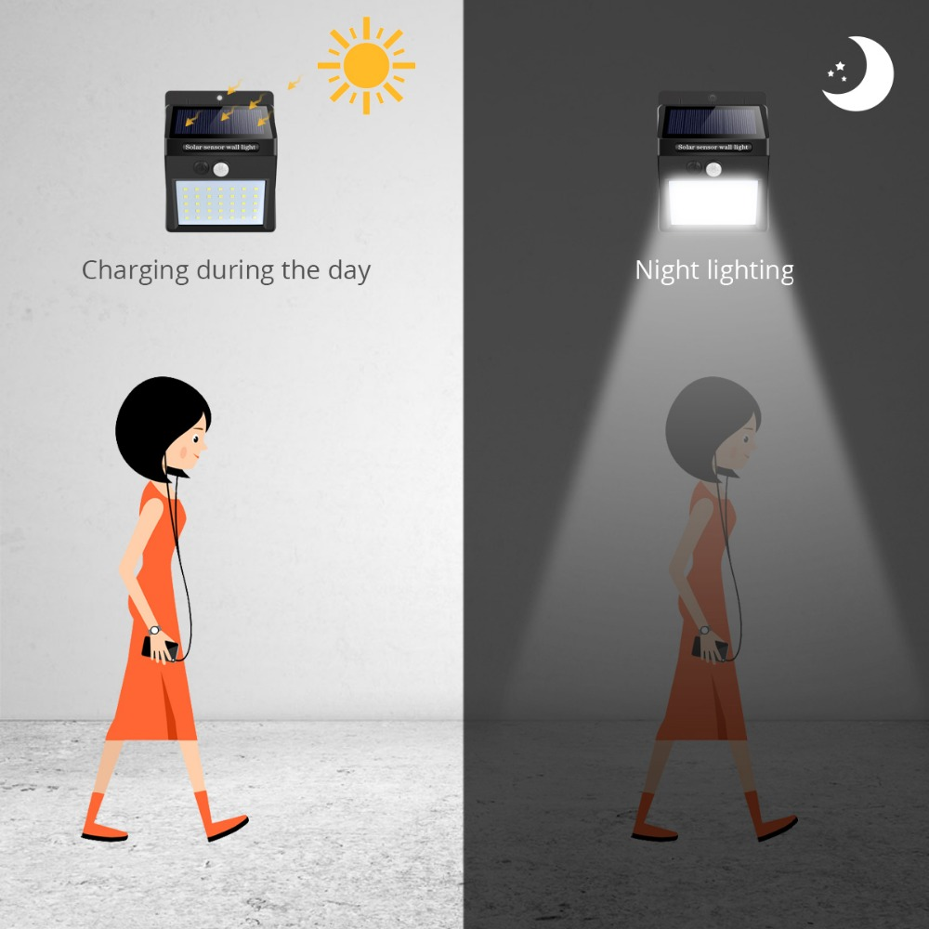

Slide 6
Apparatus:
LED
GL5537 PHOTORESISTOR
6.8 K OHM RESISTOR
9V BATTERY
SOME CONNECTING WIRES
330 OHM RESISTOR
Breadboard
7400 NAND GATE

Slide 7
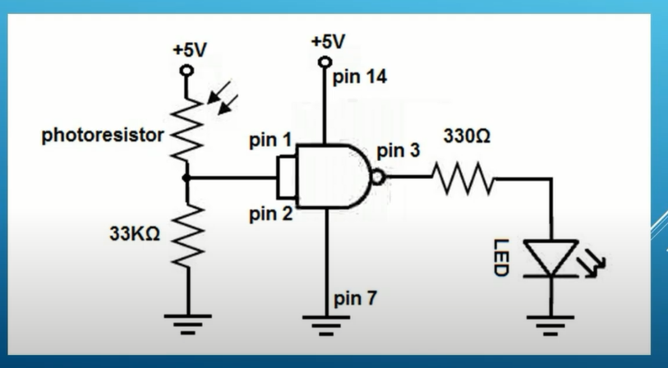
Circuit Diagram

Slide 8
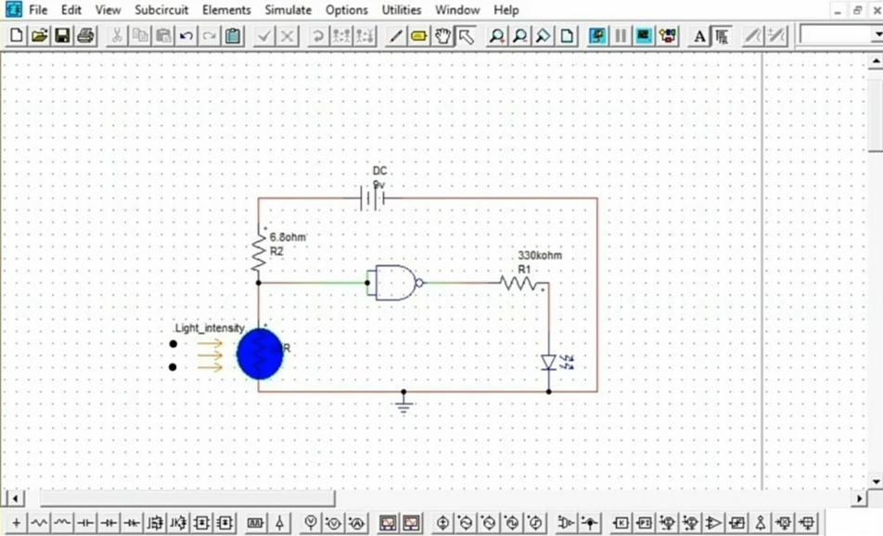
SIMULATION

Slide 9
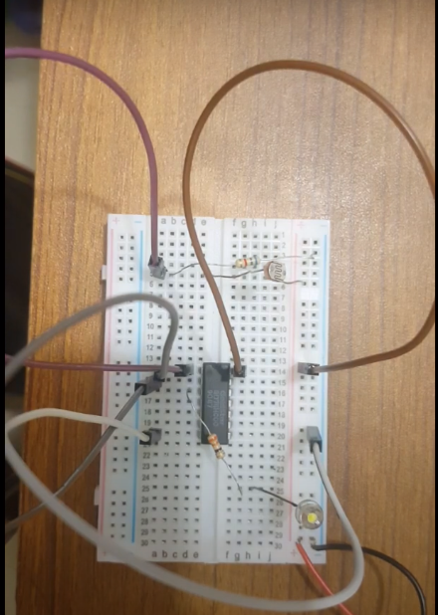
Light Off at Day

Slide 10
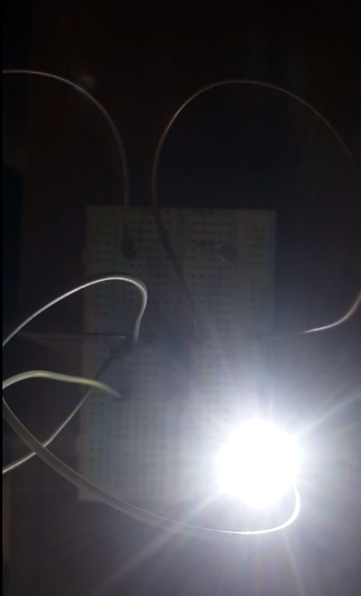
Light ON at Night

Slide 11
Procedure:
In the Circuit Photo resistor is connected to a LED. Both are connected to resistances and a power input battery.
Photoresistors, also known as light dependent resistors (LDR), are light sensitive devices most often used to indicate the presence or absence of light, or to measure the light intensity.
Due to the photo resistor, light will urn on when it is darkness of night. And the light will automatically turn itself off as we don’t need light at day

Slide 12
Procedure Explanation
The 9V battery will burn the NAND gate. So, we used a 330 OHM resistor to protect the NAND gate.
Another Resistance is added so that led bulb is not damaged by huge voltage
The ground ends of the circuit are connected to the negative point of the battery
Finally the circuit is given Voltage by adding the 9v battery

Slide 13
DISCUSSION:
In the pictures, we can see that light is off at day time when we don’t need light, whereas light automatically turns on when it is dark at day or night.
This science will help us in reducing electricity cost as the light will turn off automatically when the room or the street is not dark.
The sensor used for the project is Light Dependent Resistor, which is very much sensitive to light and changes itself to turn ON/OFF the LED in the circuit.

Slide 14
DISCUSSION:
The project was successfully proven in simulators, where the light turned on when input light source was taken away.
Conversely, the output LED was turned off when we introduced input light source to the circuit.
The project is used practically in the streets, highways, households of developed countries.

Slide 15
Thank you

